Slide 1


DESIGN AND ANALYSIS OF ALGORITHMS LABORATORY WITH MINI PROJECT [19IS4DLADA]
PROFIT ORIENTED TRANSPORTATION USING PRIM’S AND FLOYD WARSHALL ALGORITHM
LAB IN-CHARGE
Mrs. Bindu Bhargavi S M
Mrs. Shilpa Shree S
Mrs. Sreevidya B S
REINAL ANTONIO CARLO 1DS19IS077
SAI RAM V
1DS19IS082
SAI SUMANTH M
1DS19IS083
SAMARTH BS
1DS19IS084
DEPARTMENT OF ISE,DSCE

Slide 2
Contents
Introduction
System Requirements
Problem statement
Floyd Warshall Algorithm
Prim’s Algorithm
Implementation
Time complexity
Conclusion

Slide 3
Introduction
Meeting the needs of middle class people
Minimum distance they need to travel one place to another
Minimum distance they need to travel all the places.
Spending fewer amount of time and money.
Minimum travel expense and minimum time to travel by multiple means of transport.
Most profitable transportation.

Slide 4
System Requirements
Hardware Requirements
Intel (or AMD equivalent) i5 or better processor, 7th generation or newer
Minimum 1GHz CPU with four or more cores (Recommended 2GHz or more)
Minimum 1 GB RAM (Recommended 4 GB or above)
Minimum 32 GB hard drive Recommended 64 GB or more
Software Requirements
Code editor where you write the source code of your program
Integrated Development Environment (IDE) to edit and compile the c program. The best IDE’s for c programming are visual studio code, Code::Blocks, Dev-C++, Geany.
Windows or any compatible Operating system

Slide 5
Problem statement
To find minimum distance to travel from source to destination using floyd’s algorithm
To find minimum distance to travel all the places using prim’s algorithm
To find minimum travel expense
To find estimated time of travel
To find the most profitable transportation

Slide 6
Floyd Warshall Algorithm
Dynamic programming.
Solving the All Pairs Shortest Path problem.
Shortest distances between every pair of vertices in a given edge weighted directed Graph.

Slide 7
Floyd Warshall Algorithm
Pseudocode:
for i = 1 to N
for j = 1 to N
if there is an edge from i to j
dist[0][i][j] = the length of the edge from i to j
else
dist[0][i][j] = INFINITY
for k = 1 to N
for i = 1 to N
for j = 1 to N
dist[k][i][j] = min(dist[k-1][i][j], dist[k-1][i][k] + dist[k-1][k][j])

Slide 8
Prim’s Algorithm
Find the minimum spanning tree from a graph.
Finds the subset of edges that includes every vertex of the graph such that the sum of the weights of the edges can be minimized.
Starts with the single node and explore all the adjacent nodes with all the connecting edges at every step.
The edges with the minimal weights causing no cycles in the graph got selected.

Slide 9
Prim’s Algorithm
Pseudocode:
Prim(G)
//Prim's algorithm for constructing a minimum spanning tree
//Input: A weighted connected graph G = (V, E)
//Output: E_{T}, the set of edges composing a minimum spanning tree of G
V_{T}<-{V₀}//the set of tree vertices can be initialized with any vertex
E_{T}<-ø
for i <-1 to |V|-1 do
find a minimum-weight edge e* = (v*, u*) among all the edges (v, u)
such that v is in V_{T} and u is in V - V_{T}
V_{T} <- V_{T} U {u*)
E_{T} <- E_{T} U (e*)
return E_{T}

Slide 10
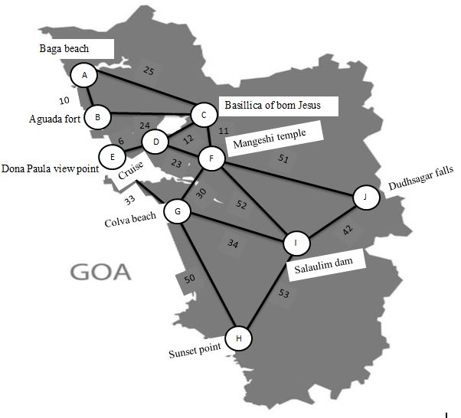
Implementation

Slide 11
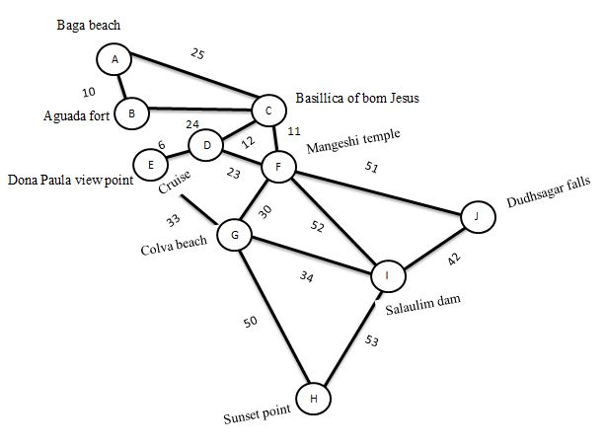
Implementation

Slide 12
Implementation
For a graph with N vertices:
Initialize the shortest paths between any 2 vertices with Infinity.
Find all pair shortest paths that use 0 intermediate vertices, then find the shortest paths that use 1 intermediate vertex and so on.. until using all N vertices as intermediate nodes.
Minimize the shortest paths between any 2 pairs in the previous operation.
For any 2 vertices (i,j) , one should actually minimize the distances between this pair using the first K nodes, so the shortest path will be: min(cost[i][k]+cost[k][j],cost[i][j]).
cost[k][j] represents the shortest path that only uses the first K vertices, cost[k][j] represents the shortest path between the pair k,j. As the shortest path will be a concatenation of the shortest path from i to k, then from k to j.

Slide 13
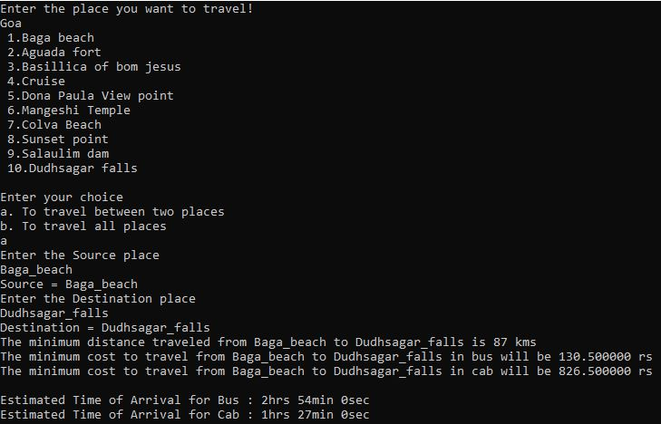
Implementation

Slide 14
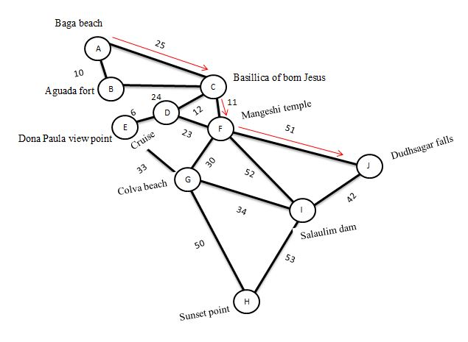
Implementation

Slide 15
Implementation
Prim’s Algorithm uses Greedy approach to find the minimum spanning tree.
Prim's algorithm finds the subset of edges that includes every vertex of the graph such that the sum of the weights of the edges can be minimized.
Prim's algorithm starts with the single node and explore all the adjacent nodes with all the connecting edges at every step.
The edges with the minimal weights causing no cycles in the graph gets selected.

Slide 16
Implementation
Lets select first 5 vertex from the graph.
In Prim’s Algorithm, we will start with an arbitrary node (here it is A).In each iteration we will mark a new vertex that is adjacent to A.
As a greedy algorithm, Prim’s algorithm will select the cheapest edge and mark the vertex. So we will simply choose the edge B with weight 10 over C with weight 25 .
In the next iteration we have only one option. So, we will select the edge C with weight 24.
Again we have only one option, that is edge with weight 12.
Now again we have only one option, that is edge with weight 6, So we will select the edge with weight 6.
We end up with the minimum spanning tree of total cost 52 (=10+24+12+6).

Slide 17
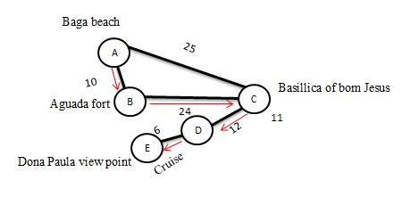
Implementation

Slide 18
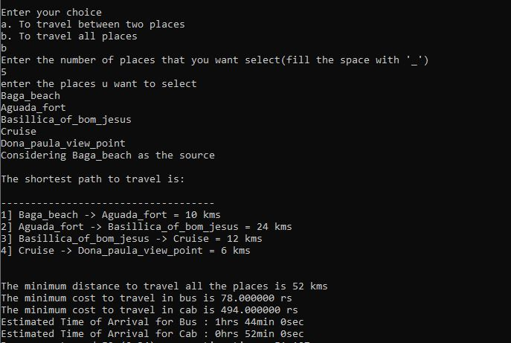
Implementation

Slide 19
Time complexity
Time Complexity of the Floyd Warshall algorithm is O(n³)
Time Complexity of the prim’s algorithm for adjacency matrix is O(n²)

Slide 20
Conclusion
This project is all about profit oriented transportation where user can find out which is the best possible way to travel all the places as well as one place to another. This is helpful for tourists. They can find out what is minimum distance to travel, which is cheapest way to travel, which is fastest way to travel.

Slide 21
Thank you

